Slide 1

Challenge 2 - Esports Tournament

Slide 2
Introduction
The top eSports competitors from across the globe have gathered to battle it out
Can you analyse the following data to find out all about the tournament?

Slide 3
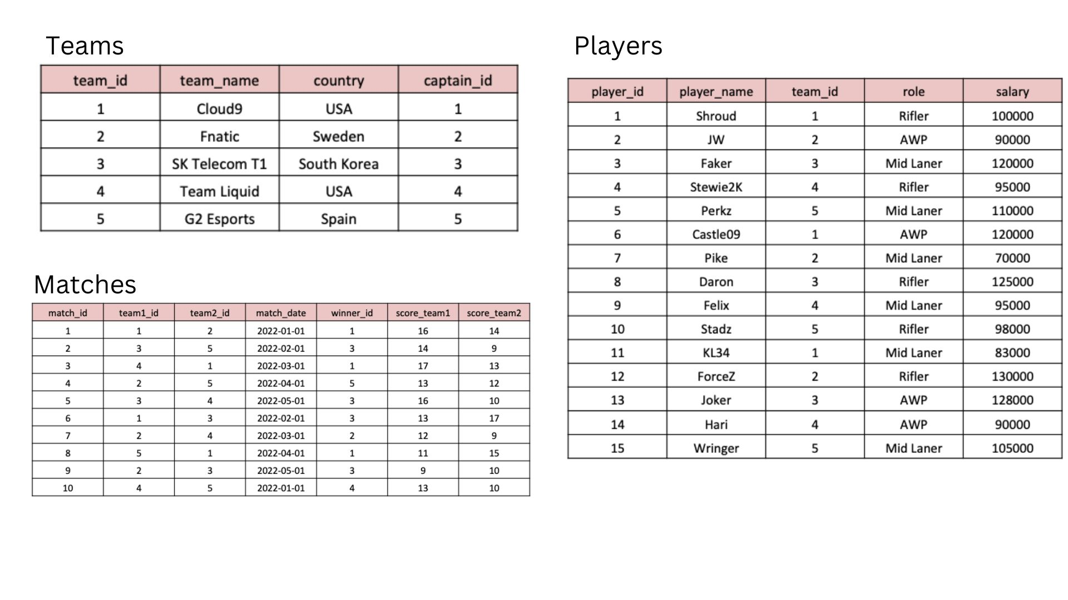
Tables

Slide 4
Create & Insert in Table-Teams
CREATE TABLE Teams (
team_id INT PRIMARY KEY,
team_name VARCHAR(50) NOT NULL,
country VARCHAR(50),
captain_id INT
);
INSERT INTO Teams (team_id, team_name, country, captain_id)
VALUES (1, 'Cloud9', 'USA', 1),
(2, 'Fnatic', 'Sweden', 2),
(3, 'SK Telecom T1', 'South Korea', 3),
(4, 'Team Liquid', 'USA', 4),
(5, 'G2 Esports', 'Spain', 5);

Slide 5
Create & Insert in Table-Players
CREATE TABLE Players (
player_id INT PRIMARY KEY,
player_name VARCHAR(50) NOT NULL,
team_id INT,
role VARCHAR(50),
salary INT,
FOREIGN KEY (team_id) REFERENCES Teams(team_id)
);
INSERT INTO Players (player_id, player_name, team_id, role, salary)
VALUES (1, 'Shroud', 1, 'Rifler', 100000), (2, 'JW', 2, 'AWP', 90000),
(3, 'Faker', 3, 'Mid laner', 120000), (4, 'Stewie2k', 4, 'Rifler', 95000),
(5, 'Perkz', 5, 'Mid laner', 110000), (6, 'Castle09', 1, 'AWP', 120000),
(7, 'Pike', 2, 'Mid Laner', 70000), (8, 'Daron', 3, 'Rifler', 125000),
(9, 'Felix', 4, 'Mid Laner', 95000), (10, 'Stadz', 5, 'Rifler', 98000),
(11, 'KL34', 1, 'Mid Laner', 83000), (12, 'ForceZ', 2, 'Rifler', 130000),
(13, 'Joker', 3, 'AWP', 128000), (14, 'Hari', 4, 'AWP', 90000),
(15, 'Wringer', 5, 'Mid laner', 105000);

Slide 6
Create & Insert in Table-Matches
CREATE TABLE Matches (
match_id INT PRIMARY KEY, team1_id INT,
team2_id INT, match_date DATE,
winner_id INT, score_team1 INT,
score_team2 INT,
FOREIGN KEY (team1_id) REFERENCES Teams(team_id),
FOREIGN KEY (team2_id) REFERENCES Teams(team_id),
FOREIGN KEY (winner_id) REFERENCES Teams(team_id)
);
INSERT INTO Matches (match_id, team1_id, team2_id, match_date, winner_id, score_team1, score_team2)
VALUES (1, 1, 2, '2022-01-01', 1, 16, 14), (2, 3, 5, '2022-02-01', 3, 14, 9),
(3, 4, 1, '2022-03-01', 1, 17, 13), (4, 2, 5, '2022-04-01', 5, 13, 12),
(5, 3, 4, '2022-05-01', 3, 16, 10), (6, 1, 3, '2022-02-01', 3, 13, 17),
(7, 2, 4, '2022-03-01', 2, 12, 9), (8, 5, 1, '2022-04-01', 1, 11, 15),
(9, 2, 3, '2022-05-01', 3, 9, 10), (10, 4, 5, '2022-01-01', 4, 13, 10);

Slide 7
Questions & Answers

Slide 8
1. What are the names of the players whose salary is greater than 100,000?
select player_name
from Players
where salary>100000;

Slide 9
2. What is the team name of the player with player_id = 3?
select t.team_name
from Teams t join Players p
on t.team_id=p.team_id
where p.player_id=3;

Slide 10
3. What is the total number of players in each team?
select t.team_id, count(p.player_id) as total_players
from Teams t join Players p
on t.team_id=p.team_id
group by t.team_id;

Slide 11
4. What is the team name and captain name of the team with team_id = 2?
select t.team_name, p.player_name as captain_of_team
from Teams t join Players p
on t.captain_id=p.player_id
where t.team_id=2;

Slide 12
5. What are the player names and their roles in the team with team_id = 1?
select player_name, role
from Players
where team_id=1;

Slide 13
6.What are the team names and the number of matches they have won?
select t.team_name, count(m.winner_id) as matches_won
from Teams t join Matches m
on t.team_id=m.winner_id
group by m.winner_id;

Slide 14
7. What is the average salary of players in the teams with country 'USA'?
select avg(salary) as avg_salary
from Players p join Teams t
on p.team_id=t.team_id
where t.country='USA';

Slide 15
8. Which team won the most matches?
select t.team_name, count(m.winner_id) as matches_won
from Teams t join Matches m
on t.team_id=m.winner_id
group by m.winner_id
order by matches_won desc limit 1;

Slide 16
9. What are the team names and the number of players in each team whose salary is greater than 100,000?
select t.team_name, count(p.player_id) as number_of_players
from Teams t join Players p
on t.team_id=p.team_id
where p.salary>100000
group by t.team_name;

Slide 17
10. What is the date and the score of the match with match_id = 3?
select match_date, score_team1, score_team2
from Matches
where match_id=3;

Slide 18

Thank You!

